Slide 1
Automated In-Plant Line Inspection Reporting System
Jufrey Niño E. Bayog
John Paul S. Bobila
Systems Development
PIMD-ICT

Slide 2
Presentation Outline
Background
Advantages
Data Gathered
User Roles
Process Flow
Swimlane
Database Structure

Slide 3
What is the NMIS AIPLIRS
The Automated In-Plant Inspection Reporting System (AIPLIRS) is an online service that may be used by Plant Operation Standards and Monitoring Division for the report of Inspection Antemortem and Postmortem.
It generates and help the office for the Monitoring of daily report, monthly report

Slide 4
Advantages
Provide an real-time report specially for the Central office
Provide an efficient way of reporting of every Meat Inspector Officer, Meat Establishments, POSMS, POSMD
Monitoring of Post-mortem, Ante-mortem
Diseases Alerts

Slide 5
Data Gathered
Conduct interview on the End-User(POSMD) for the process flow
Conduct interview on the IT unit for the last issue found in AIPLIRS developed by third-party
Process Flow manual
Form for reporting (DMIR, MMIR, DRR)
Example output for the reporting
Access to the system developed by third-party(AIPLIRS)
Database Structure

Slide 6
User roles
ME
Manage the Daily Receiving Report.
MIO
Manage the plants assigned.
Manage the Daily Meat Inspection Report.
Manage the Monthly Meat Inspection Report.
Manage the Diseases report

Slide 7
User roles
POSMS
Manage the plants under region.
Approve or return for correction on the submitted Daily Receiving Report.
Manage the Daily Receiving Report under region.
Manage the Daily Meat Inspection Report under region.
Manage the Monthly Meat Inspection Report under region.
Managing the Diseases Reported under region.
POSMD
Manage all plants.
Manage all Daily Receiving Report.
Manage all Daily Meat Inspection Report.
Manage all Monthly Meat Inspection Report.
Managing all Diseases Reported

Slide 8
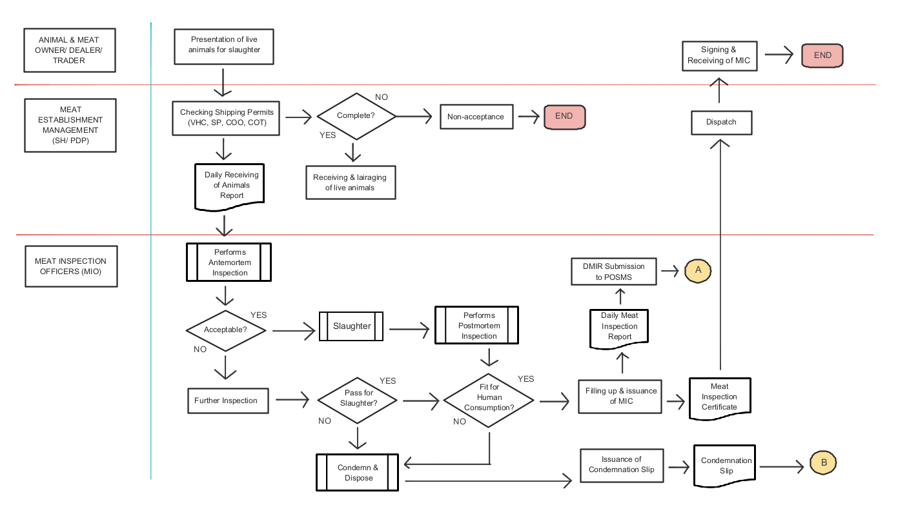
Process Flow

Slide 9
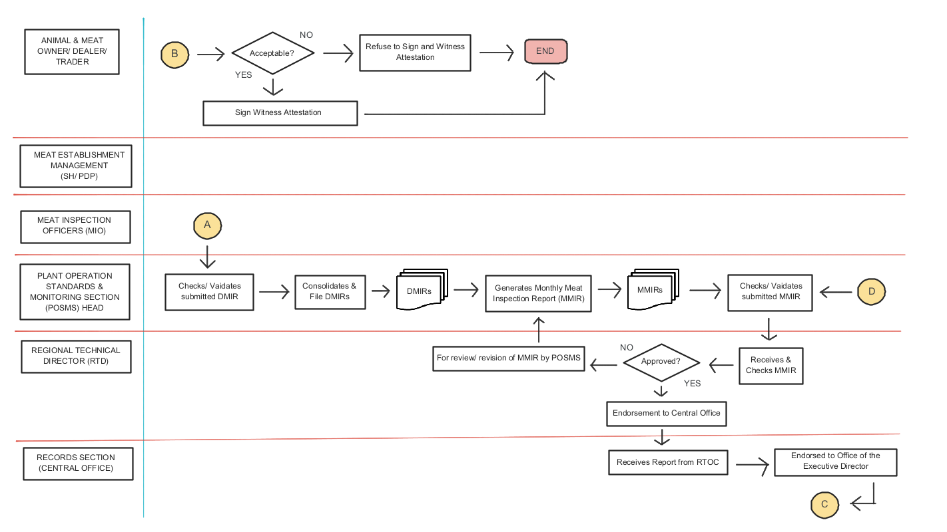
Process Flow

Slide 10
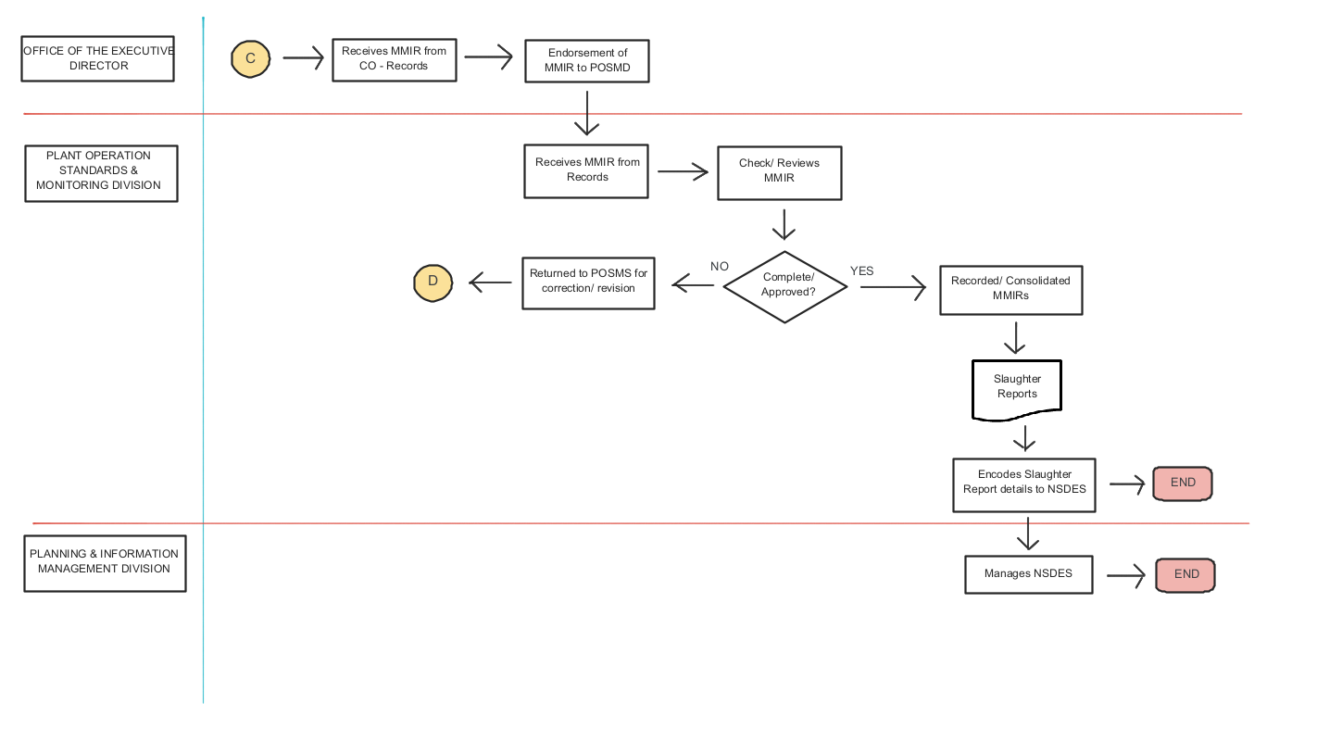
Process Flow

Slide 11
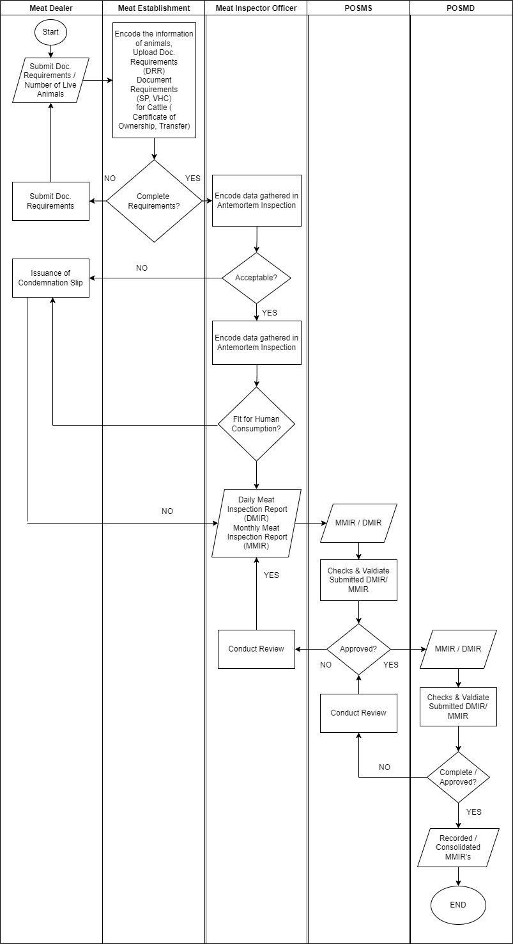
Swimlane

Slide 12
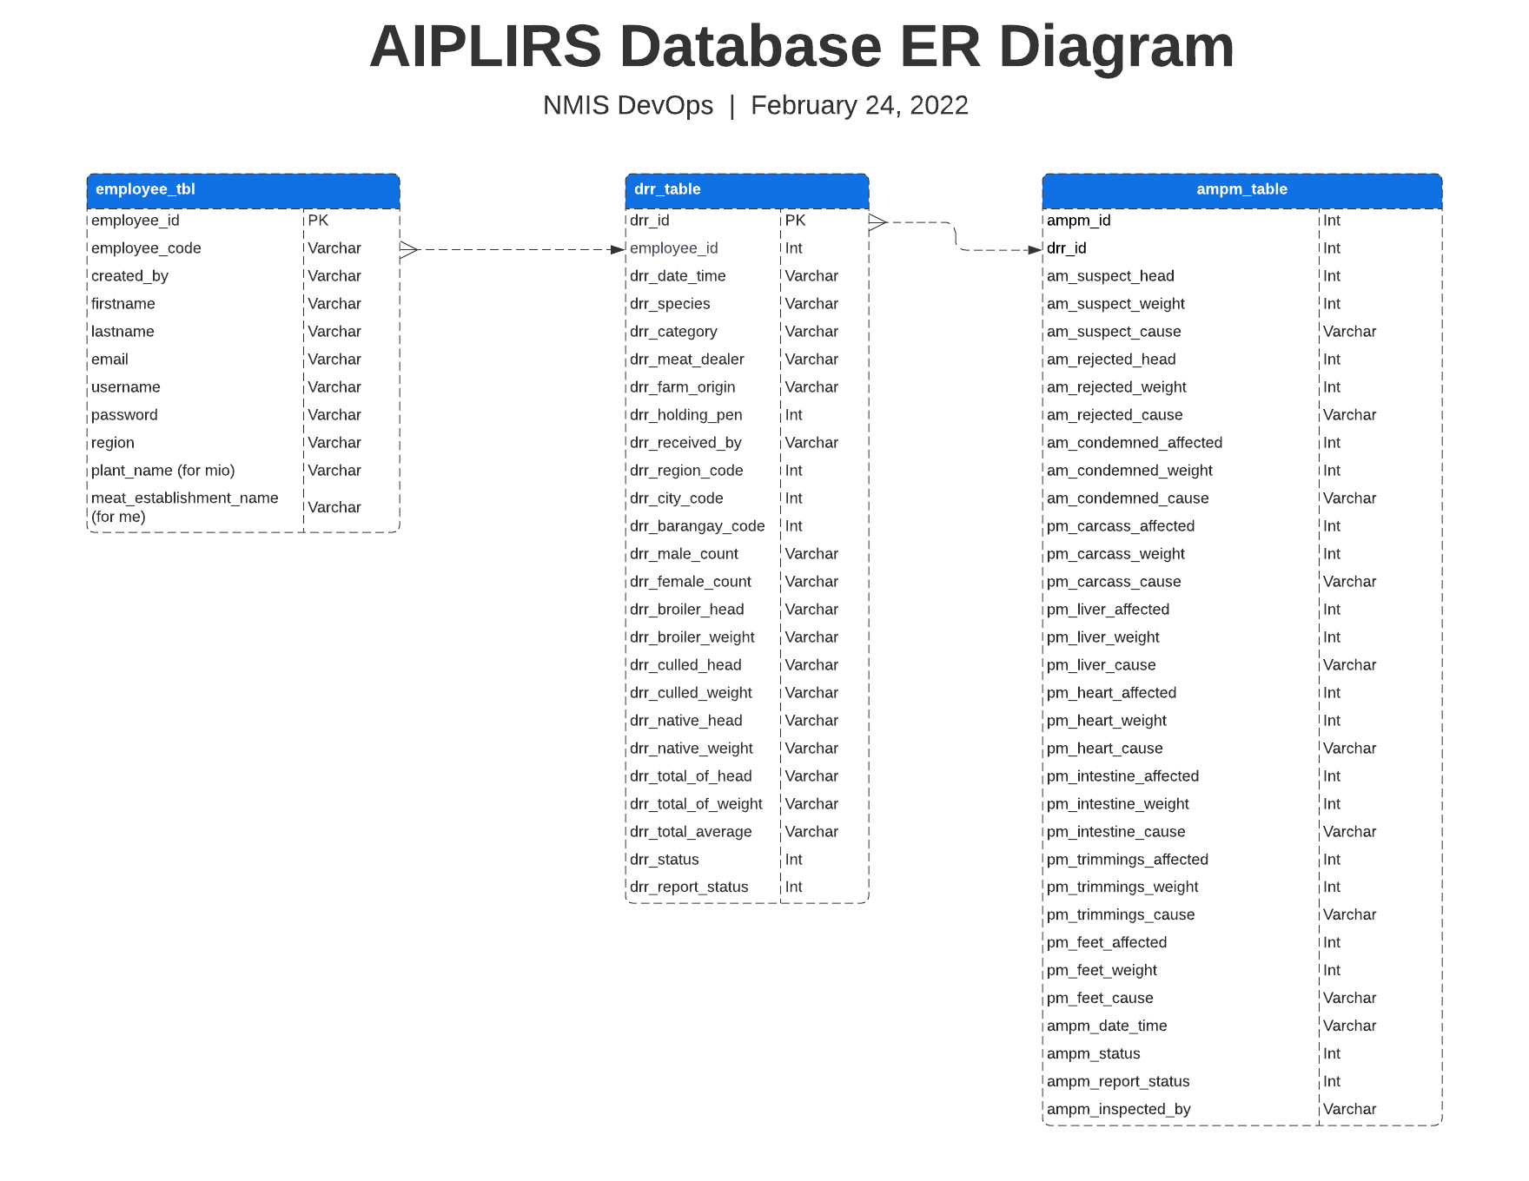
Database Structure

Slide 13
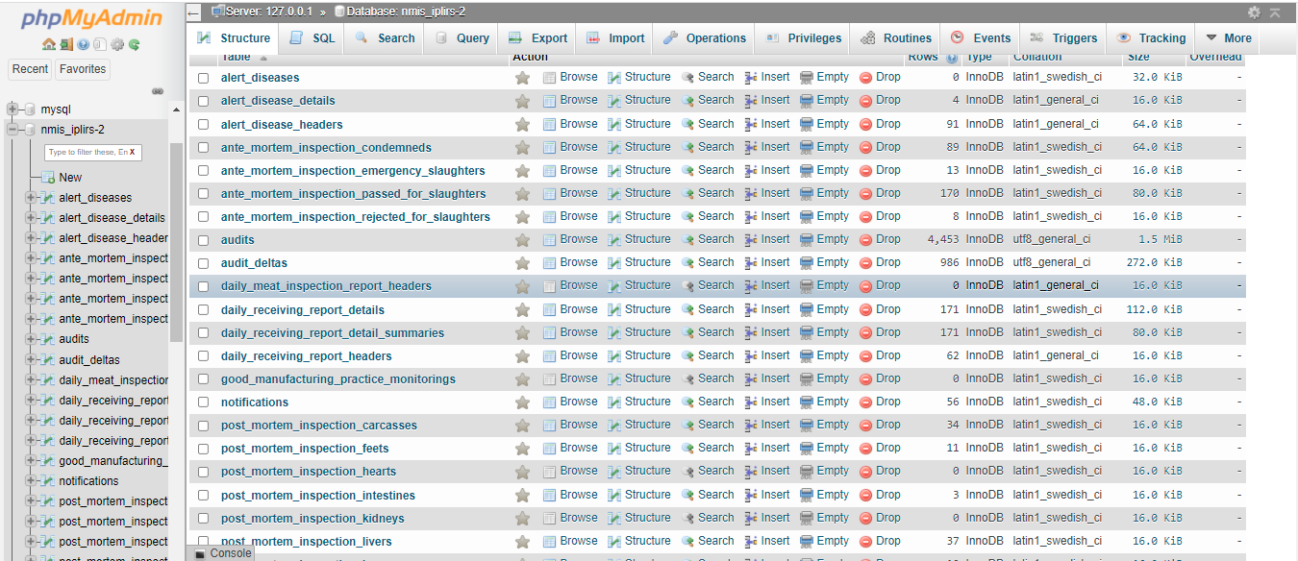

Slide 14
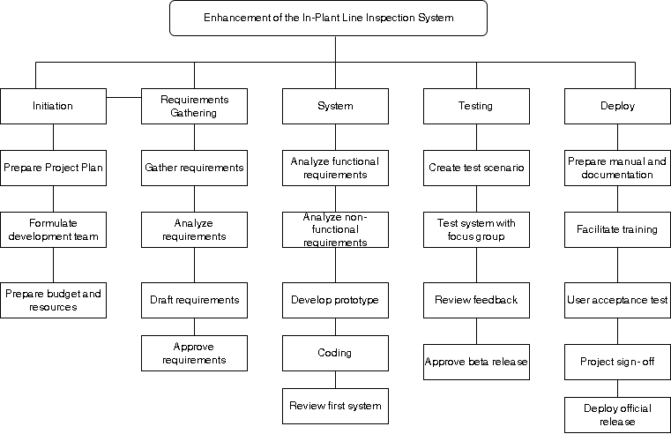
Work Breakdown Structure

Slide 15


